Slide 1

Marketing and Retail Analysis
Made By: Anmol Tripathi
PGP-DSBA Online September_A 2021-22

Slide 2
Project Objective
The data set provided constitutes the data of a café Chain for one of it’s restaurants. We need to do a thorough analysis of the data and come upwith following analysis:
Exploratory Analysis
Menu Analysis

Slide 3
Exploratory Analysis
Exploratory Analysis of data & an executive summary (in PPT) of your top findings, supported by graphs.
What kind of trends do you notice in terms of consumer behavior over different times of the day and different days of the week? Can you give concrete recommendations based on the same?
Are there certain menu items that can be taken off the menu?
Are there trends across months that you are able to notice?

Slide 4
Menu Analysis
Identify the most popular combos that can be suggested to the restaurant chain after a thorough analysis of the most commonly occurring sets of menu items in the customer orders. The restaurant doesn’t have any combo meals. Can you suggest the best combo meals?
Use of Market Basket Analysis (Association Rules)
▪ Write Something about the association rule and its relevance in this case
▪ Add KNIME workflow Image or Python package used
▪ Write about threshold values of Support and Confidence

Slide 5
Menu Analysis
Associations Identified
▪ Put the associations in a tabular manner
▪ Explain about support, confidence, & lift values that are calculated
The suggestion of Possible Combos with Lucrative Offers:
▪ Write recommendations
▪ Make discount offers or combos ( or buy two get one free) based on the associations and your experience

Slide 6
What is the data available for Analysis?
The owner of the restaurant wants you to use this data to come up with a set of recommendations that can help his Café Chain increase its revenues. He is able to provide you with a data set for POS (point of sale data) for one of his chains.

Slide 7
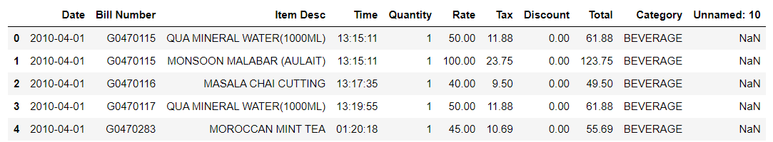
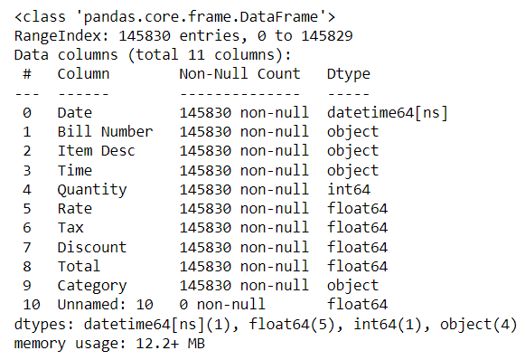
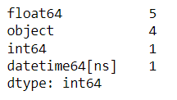
Data Set Description
There are no null values present in the data set. Also, the value count of data types are mentioned.

Slide 8

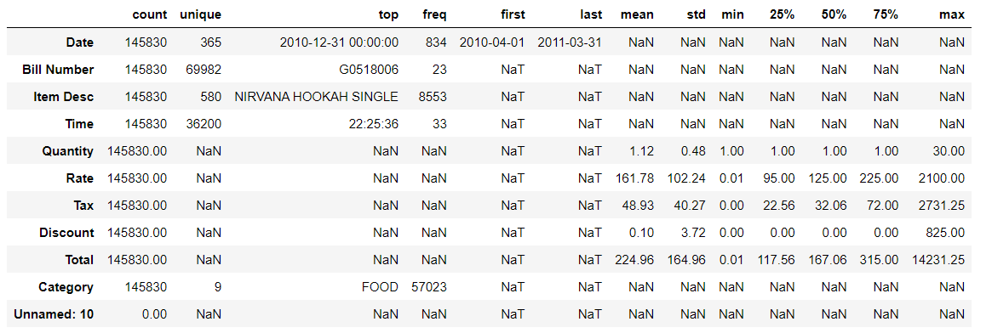
Descriptive Statistics

Slide 9
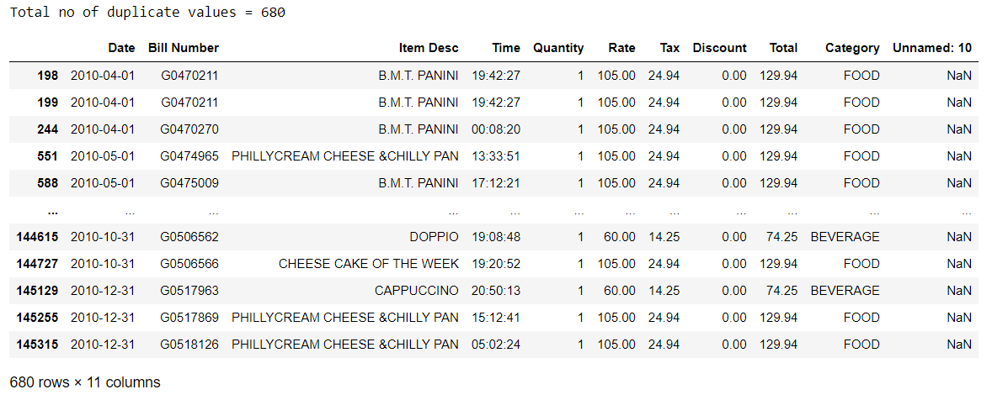
Treatment on Duplicative Values
Duplicate values were identified and then were dropped

Slide 10
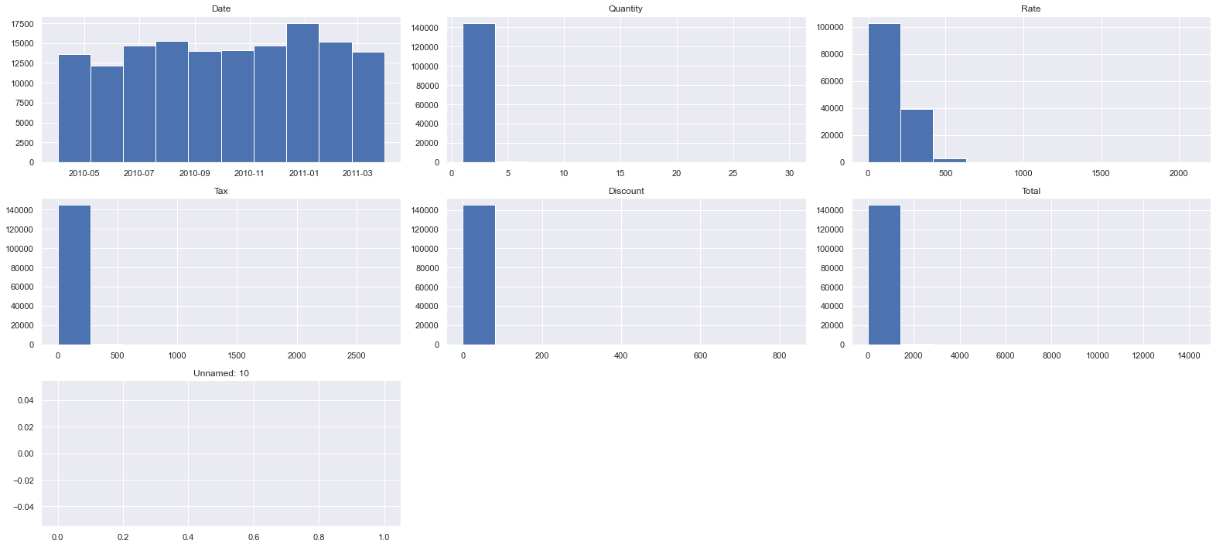
Distribution of Data using Histograms

Slide 11
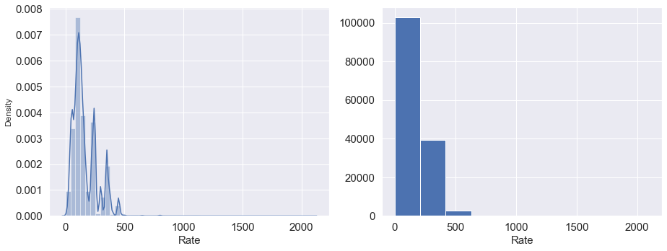
Univariate Analysis
rate:
Range of values: 2099.99
Minimum Age: 0.01
Maximum Age: 2100.0
Mean value: 161.72778277643812
Median value: 125.0
Standard deviation: 102.21351433519563
Null values: False

Slide 12
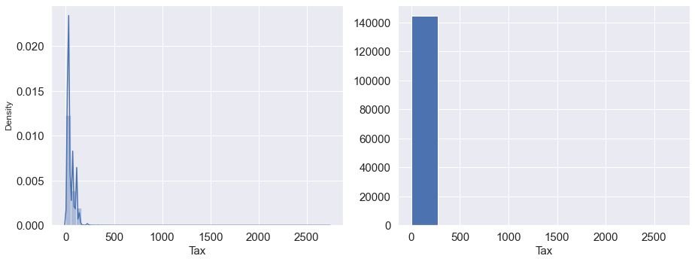
Univariate Analysis
(b) tax:
Range of values: 2731.25
Minimum Age: 0.0
Maximum Age: 2731.25
Mean value: 48.93175046502943
Median value: 32.06
Standard deviation: 40.28672042390153
Null values: False

Slide 13
Univariate Analysis
(b) total:
Range of values: 2099.99
Minimum Age: 0.01
Maximum Age: 2100.0
Mean value: 161.72778277643812
Median value: 125.0
Standard deviation: 102.21351433519563
Null values: False

Slide 14
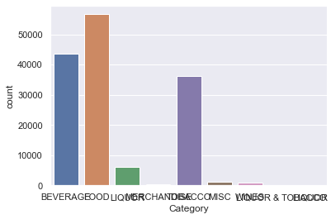
Univariate Analysis
Category

Slide 15
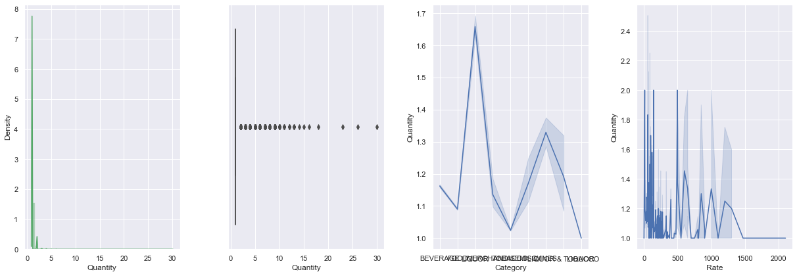
Numerical Variable Analysis
Statistical description of the numeric variable, histogram or distplot to view the distribution , box plot to view 5-point summary and outliers if any and line plots of Variable with Sales and Deal size .

Slide 16
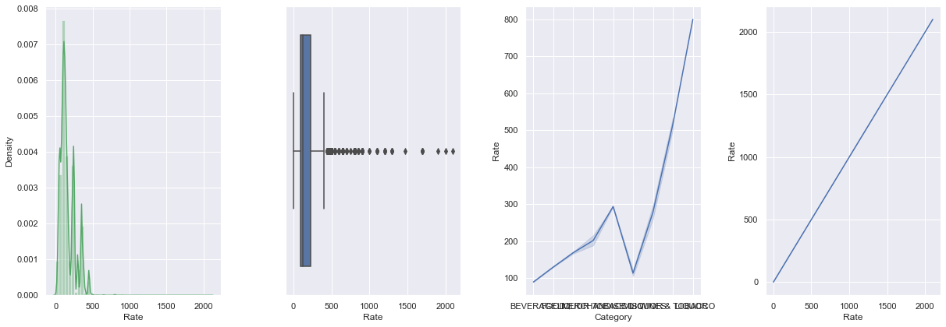
Numerical Variable Analysis
Statistical description of the numeric variable, histogram or distplot to view the distribution , box plot to view 5-point summary and outliers if any and line plots of Variable with Sales and Deal size .

Slide 17
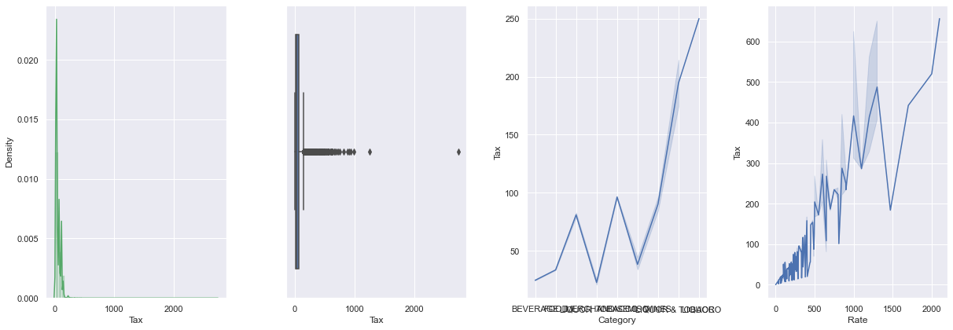
Numerical Variable Analysis
Statistical description of the numeric variable, histogram or distplot to view the distribution , box plot to view 5-point summary and outliers if any and line plots of Variable with Sales and Deal size .

Slide 18
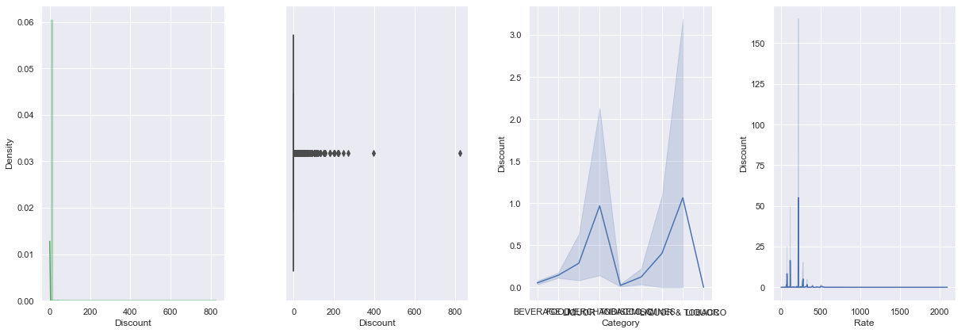
Numerical Variable Analysis
Statistical description of the numeric variable, histogram or distplot to view the distribution , box plot to view 5-point summary and outliers if any and line plots of Variable with Sales and Deal size .

Slide 19
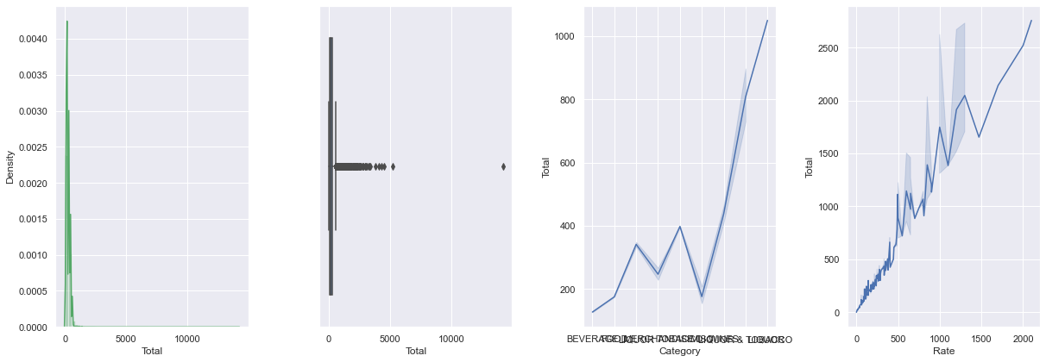
Numerical Variable Analysis
Statistical description of the numeric variable, histogram or distplot to view the distribution , box plot to view 5-point summary and outliers if any and line plots of Variable with Sales and Deal size .

Slide 20
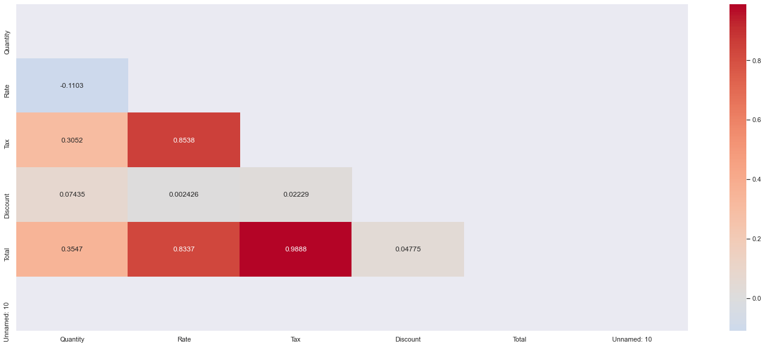
Bi Variate Analysis
From the correlation plot, we can see that various attributes of the Items are highly correlated to each other. Correlation values near to 1 or -1 are highly positively correlated and highly negatively correlated respectively. Correlation values near to 0 are not correlated to each other.

Slide 21
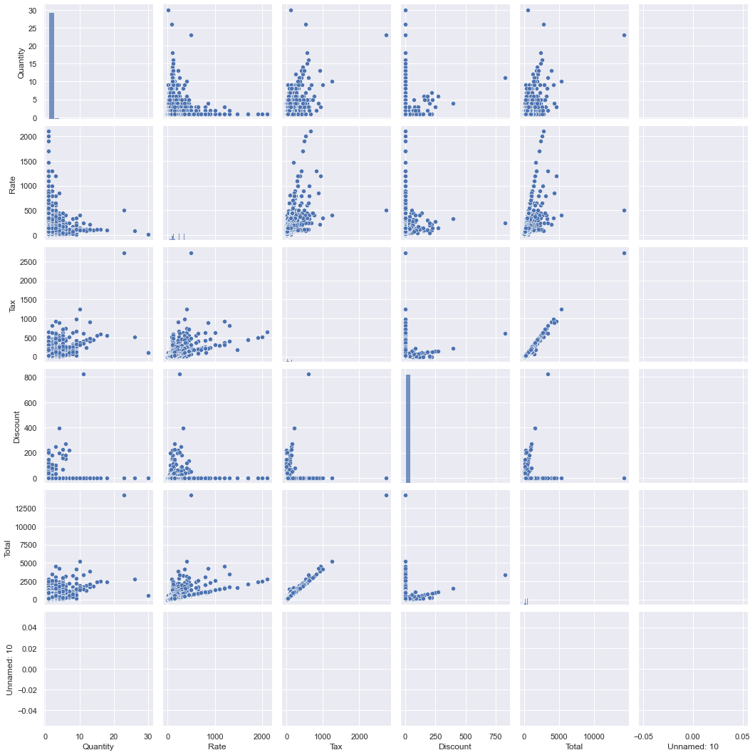
Multivariate Analysis
Pair plot shows the relationship between the variables in the form of scatterplot and the distribution of the variable in the form of histogram.
From graph, we can see that there is positive linear relationship between some variables.
The histograms bear proof of the inherent skewness in the attributes

Slide 22
Tableau Public Link
https://public.tableau.com/views/MRAProject_16622511432610/Sheet1?:language=en-GB&publish=yes&:display_count=n&:origin=viz_share_link

Slide 23
Exploratory Analysis
Café Chain Analysis

Slide 24
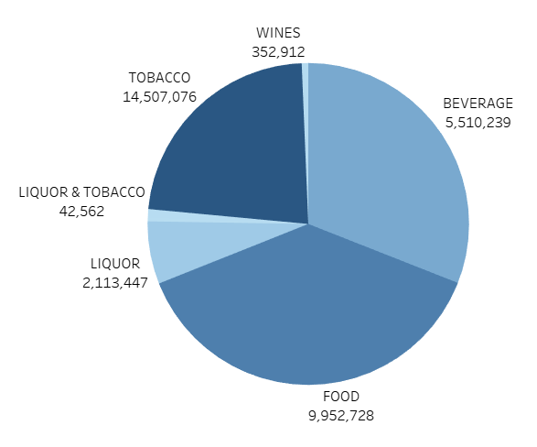
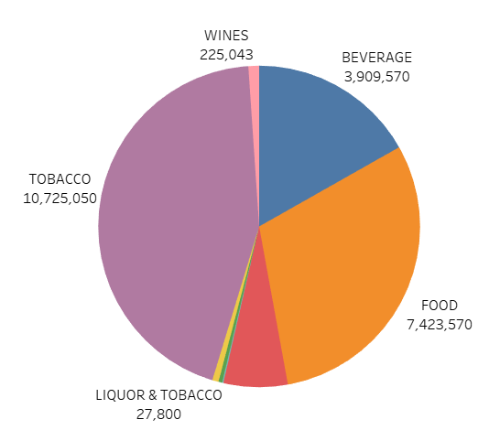
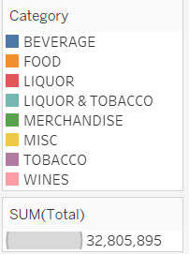
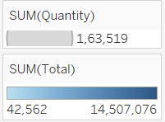
Quantity Share Vs. Revenue Share
Food is the most sold category
Tobacco contributes for the most Revenue

Slide 25
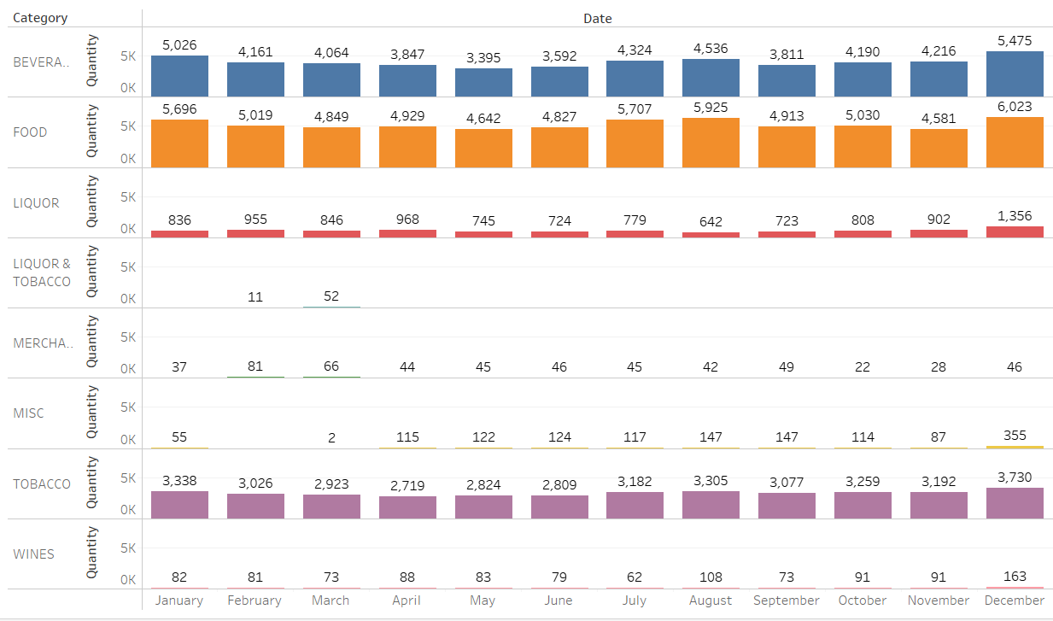
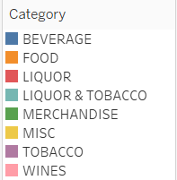
Revenue broken down to months
December month tops in the sales

Slide 26
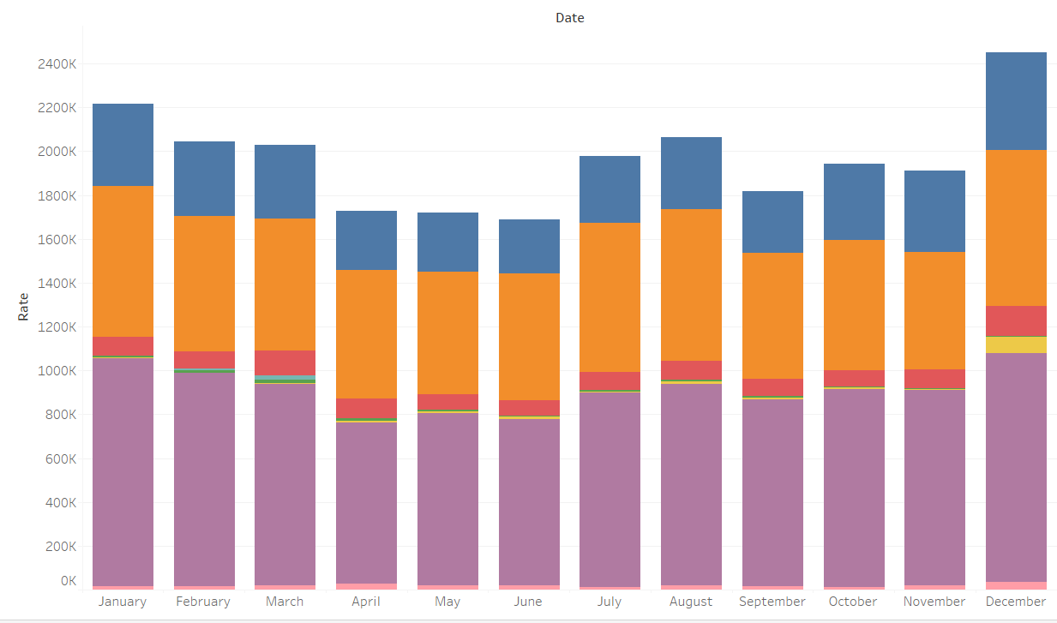
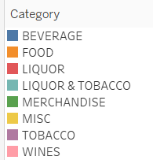
Sales across the Year
Sales have remained consistent throughout the year… No sharp peaks observed… December being the highest amongst all the months.

Slide 27
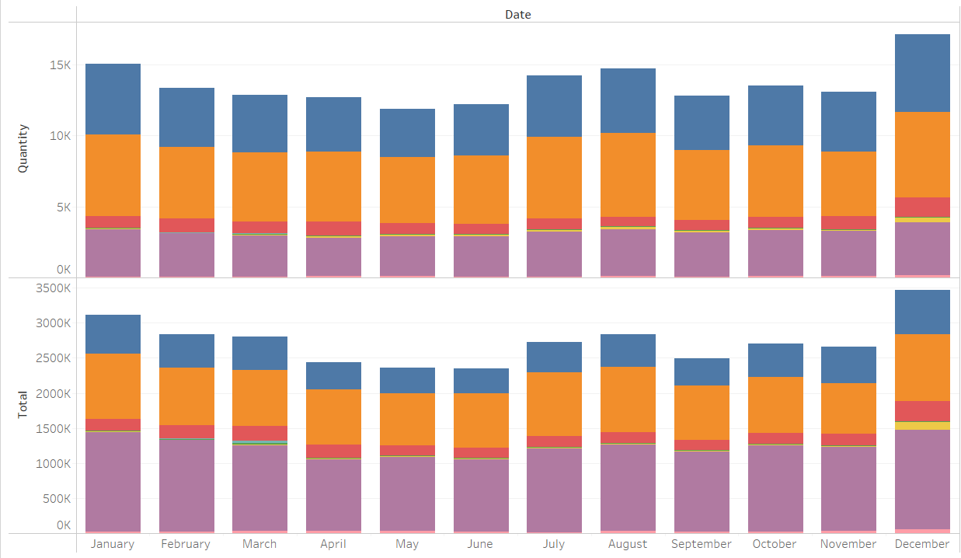
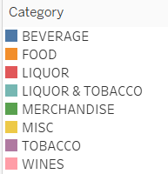
Revenue and Sum of Quality broken down to months
Tobacco, Food and beverages are top contributors !!!

Slide 28
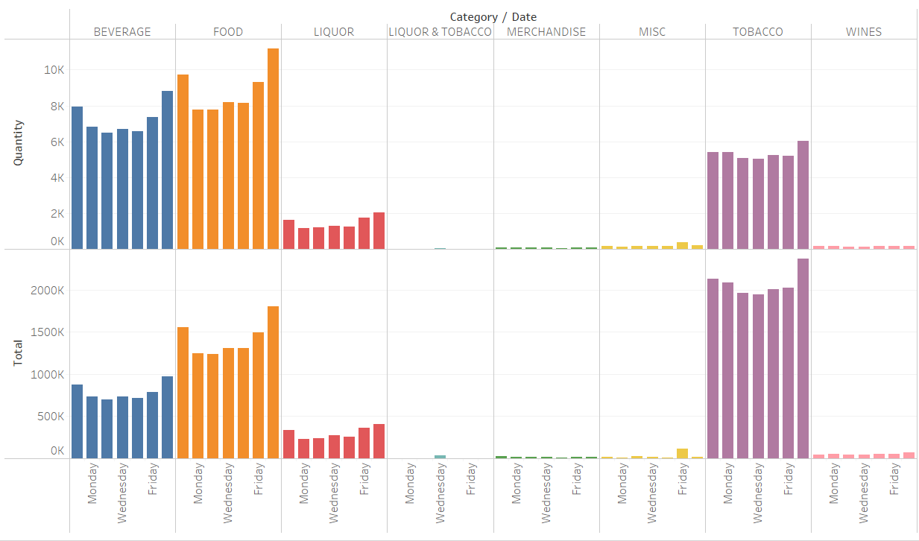
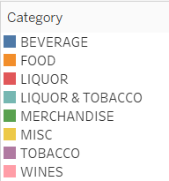
Sales based on Day of Week
Sales peak over the weekend (Friday to Sunday). Reaches peak on Saturday…

Slide 29
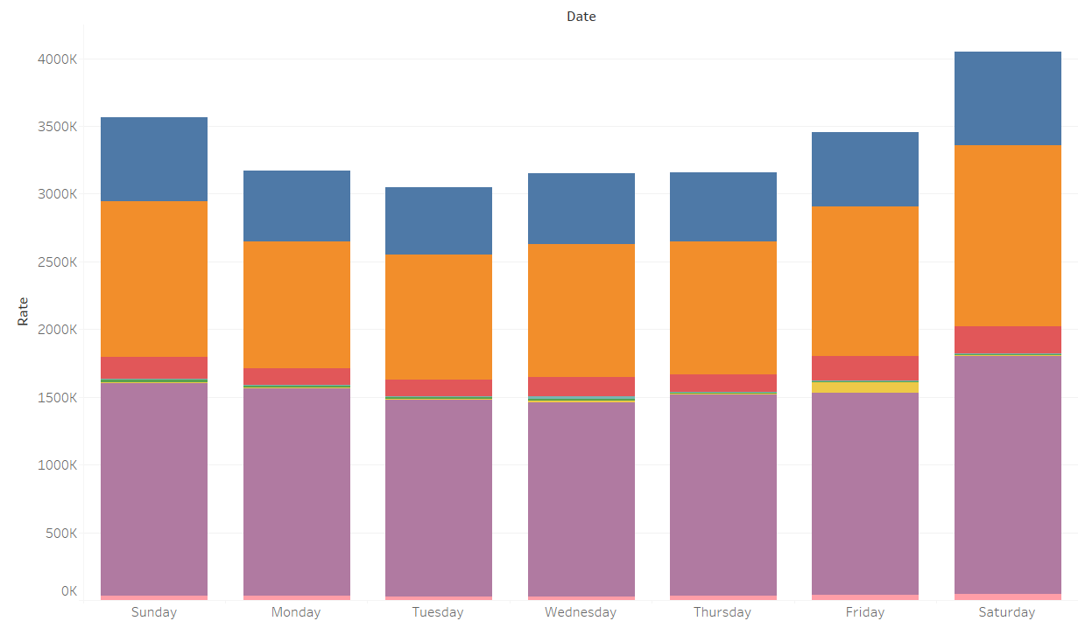
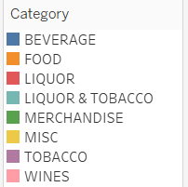
Number of Transactions broken on a day level
Number of Transactions are the most for the Saturday..

Slide 30
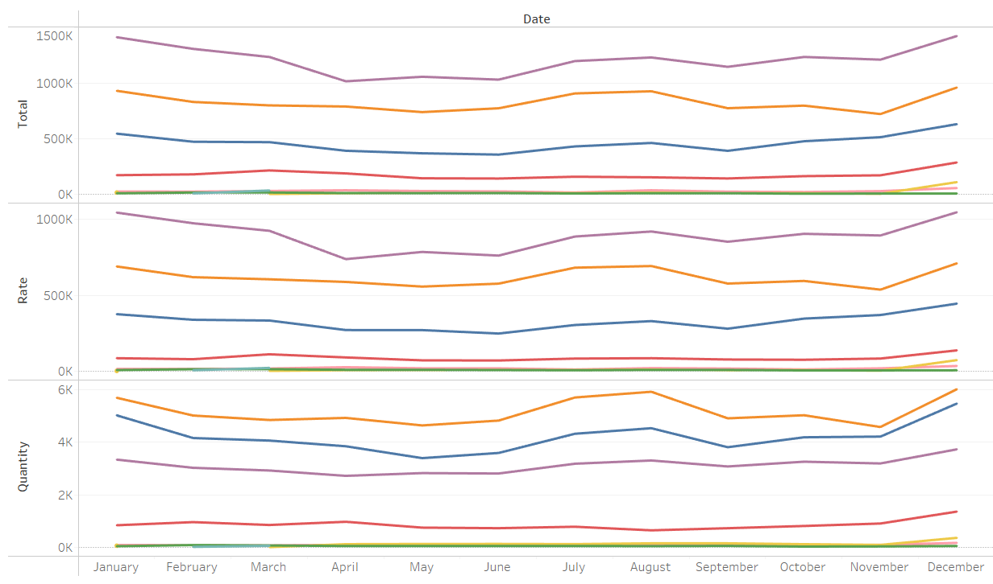
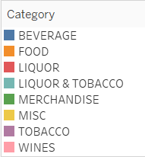
Distribution of Sales
Though Sales are higher on Saturday, it is even distributed across the week with no sharp peaks !!!

Slide 31
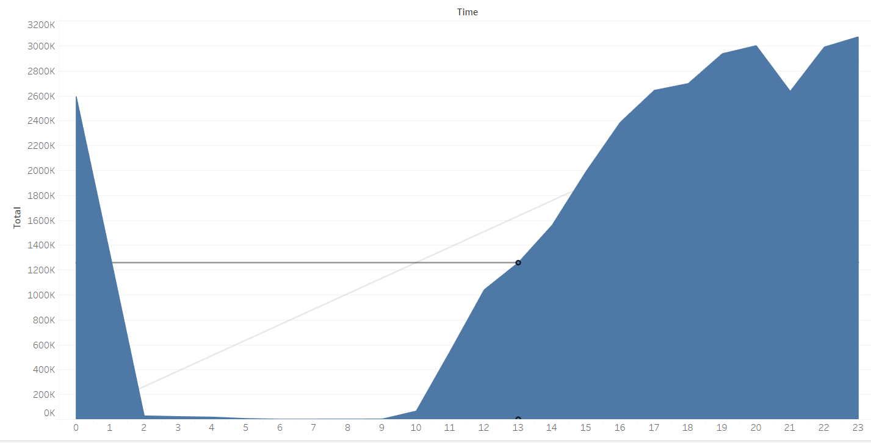
Sales Trend Across Hours
Sales steadily increase after 11 hours and peaks between 19:00 to 20:00 hours. Sales are maximum in a day between 19:00 to 23:00 hours !!!

Slide 32
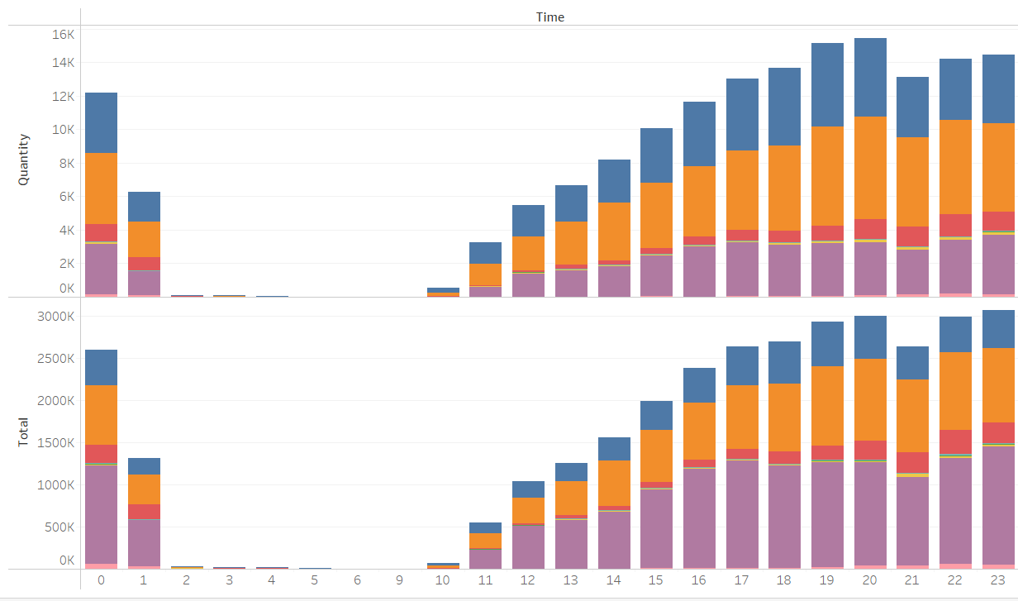
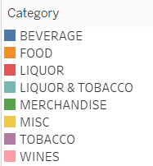
Sales across Categories during peak hours
Tobacco contributes to the highest Sales in peak hours. In terms of Quantity food tops the other categories !!!

Slide 33
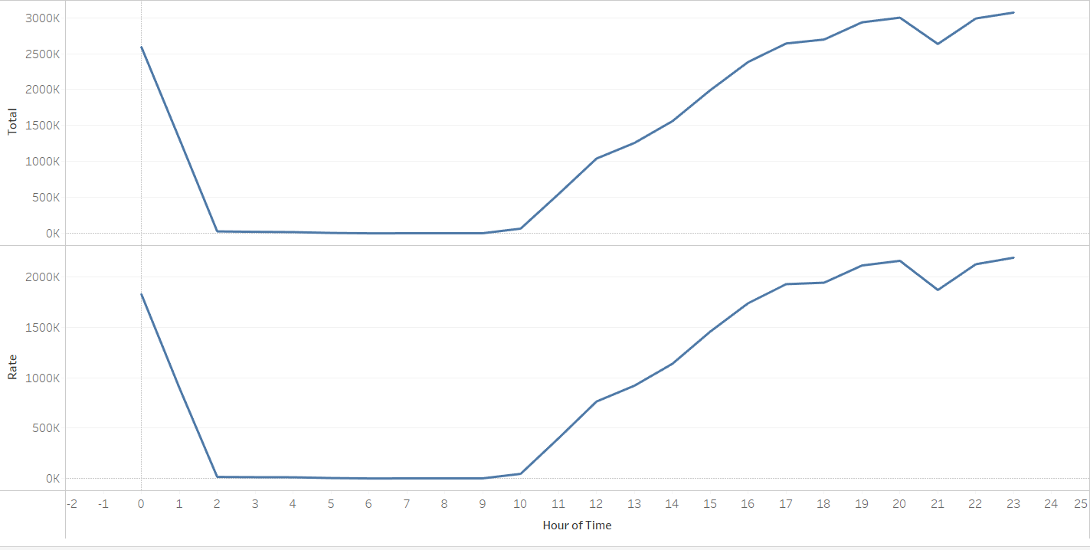





Variations in Sales across Hours
There are certain hours in a day where the sales are below 0.2% which is between 2 am to 10 am

Slide 34
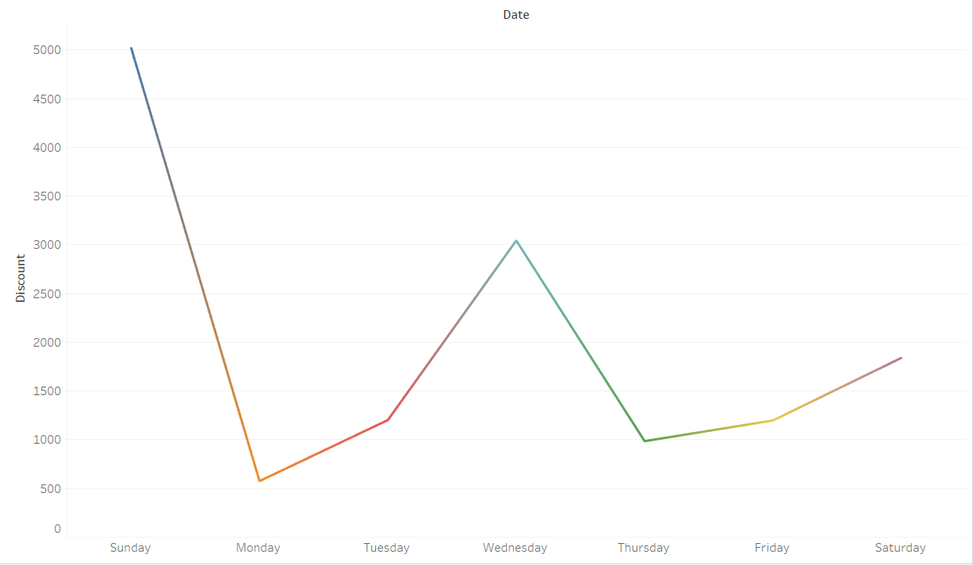
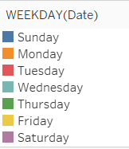
Discount trend across the week
Sunday and Wednesday have higher discounts…
After hours 13 -15 and night hours have higher discounts…

Slide 35
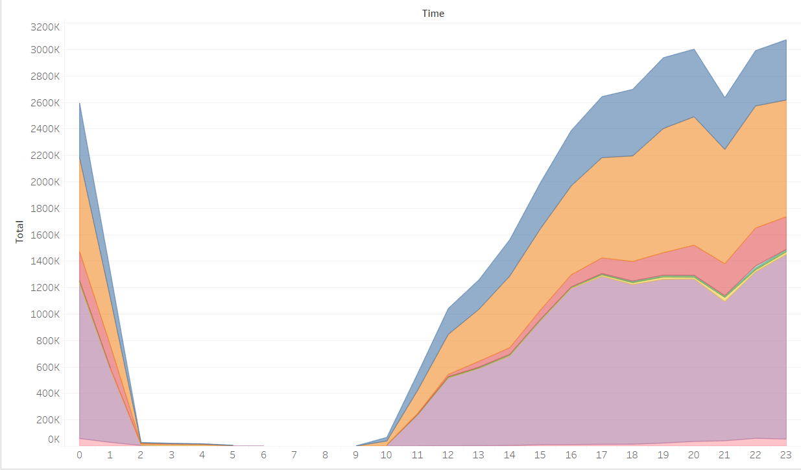
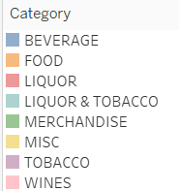
Peak time of various Categories
Peak time for beverages are 4pm to 8pm
Peak time for food items are 4pm to midnight
Peak time for liquor is between 11am to midnight
Peak time for tobacco is noon to midnight.
Tobacco, Liquor and merchandise see sales mostly at night.
Tobacco and wines are sold throughout but sales peak at night.

Slide 36
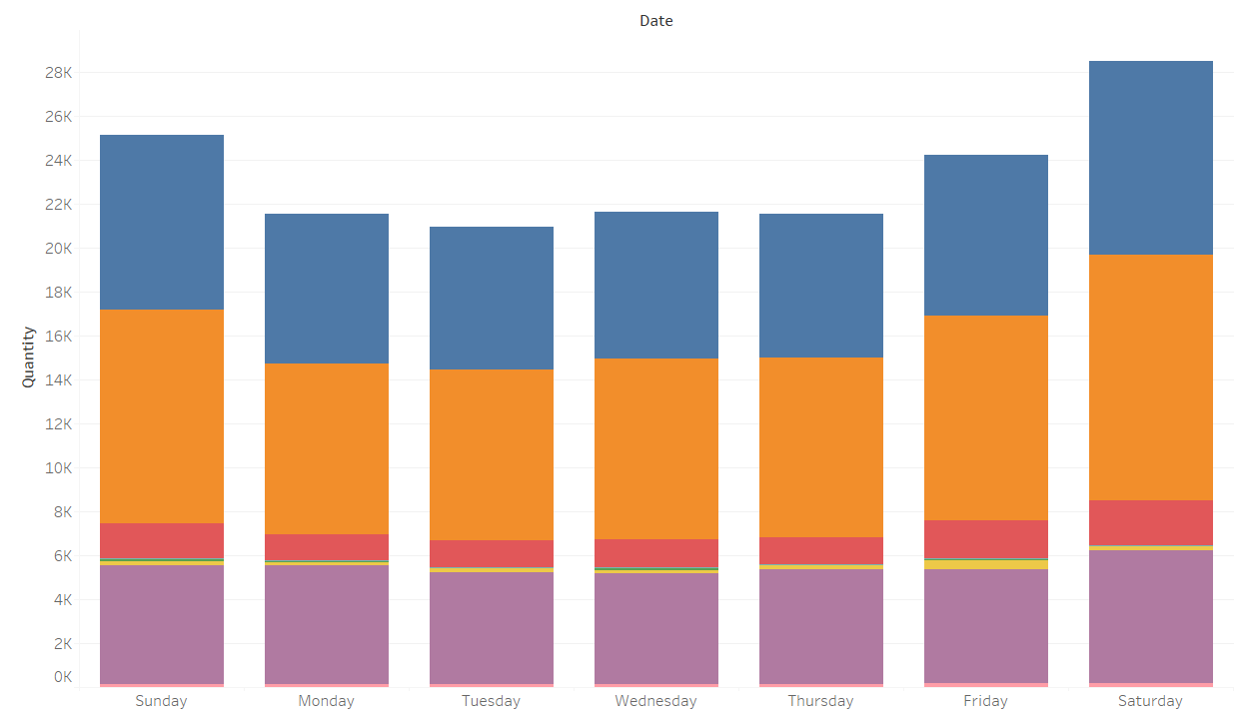
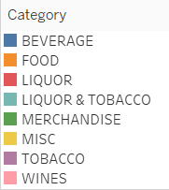
Preference based on week days
Tobacco and beverage are preferred along with food highly on Saturdays !!!

Slide 37
Summary and Key Findings
One year of data:
Analysis is performed on single financial year data starting 1st April 2010 to 31st March 2011 for the café Chain
No Significant trend / seasonality visible:
The data is constant across weekdays and across months with 20% increase in sales on Saturdays which will be due to weekend rush. Sales gradually increase from Friday, reach a peak on Saturday and is high on Sunday and is constant across weekdays.

Slide 38
Summary and Key Findings
Tobacco Contribution is higher:
Almost 40% of the Sales and Revenue is from Tobacco
Top Categories:
Food, Tobacco and Beverages are the top selling categories. These can be considered from the combo selection to increase sales.
Discounts:
Discounts can be given for bills of the higher value and also to the customers who are frequent the café to ensure they visit again.

Slide 39
Menu Analysis
Café Chain Analysis

Slide 40
Menu Delisting
Items which are sold less than 20 times in year can be removed off the list for categories other than wines.
For wines, items sold less than 5 times can be removed off the list.

Slide 41
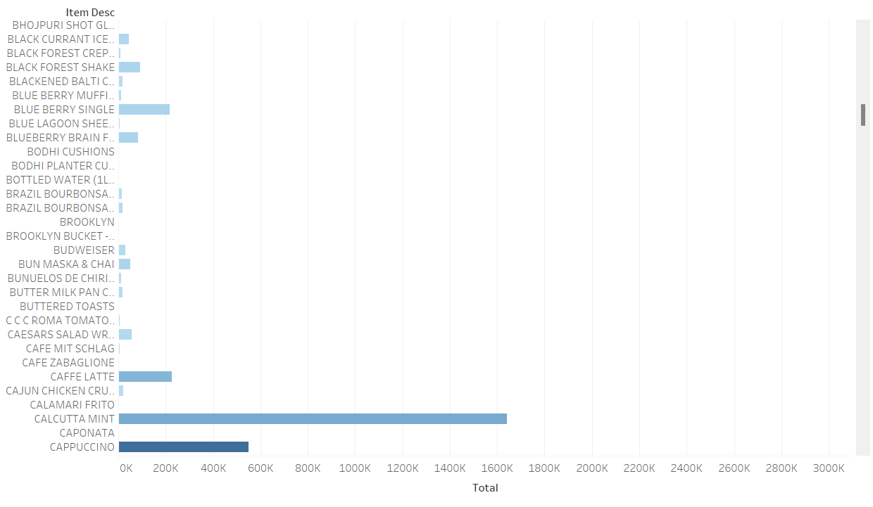
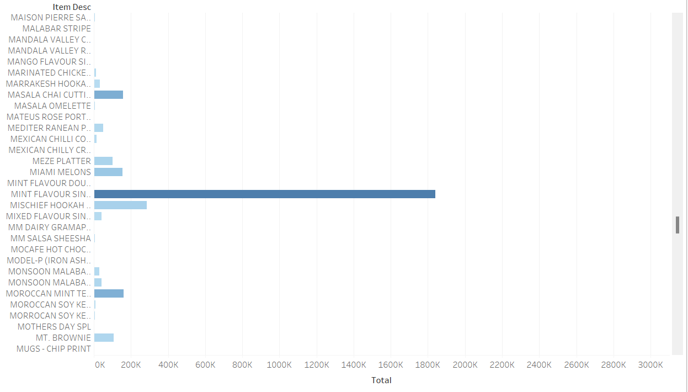
Food which are sold less Frequently
Notes:
Here we have just posted couple of snapshots of the data. More information is already attached in the table which can be checked easily.

Slide 42
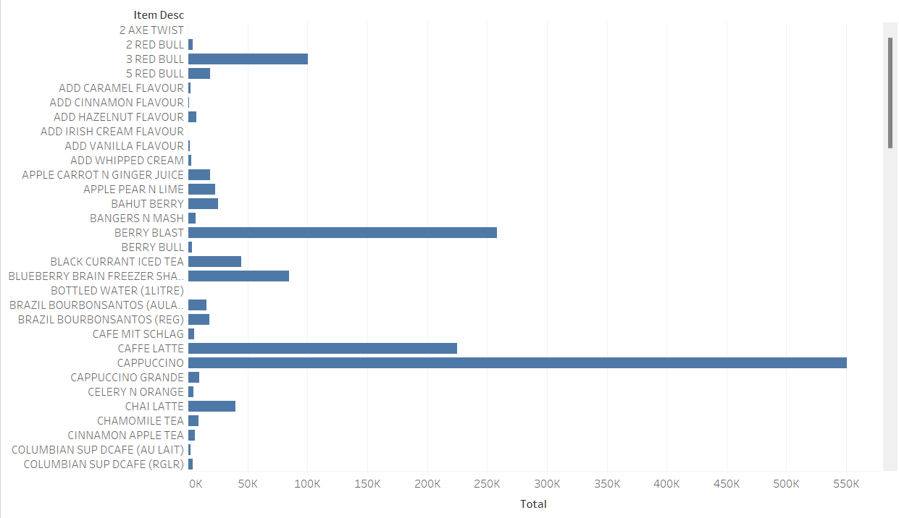

Beverages that are sold less
Notes:
Here we have just posted a snapshot of the data. More information is already attached in the table which can be checked easily.

Slide 43
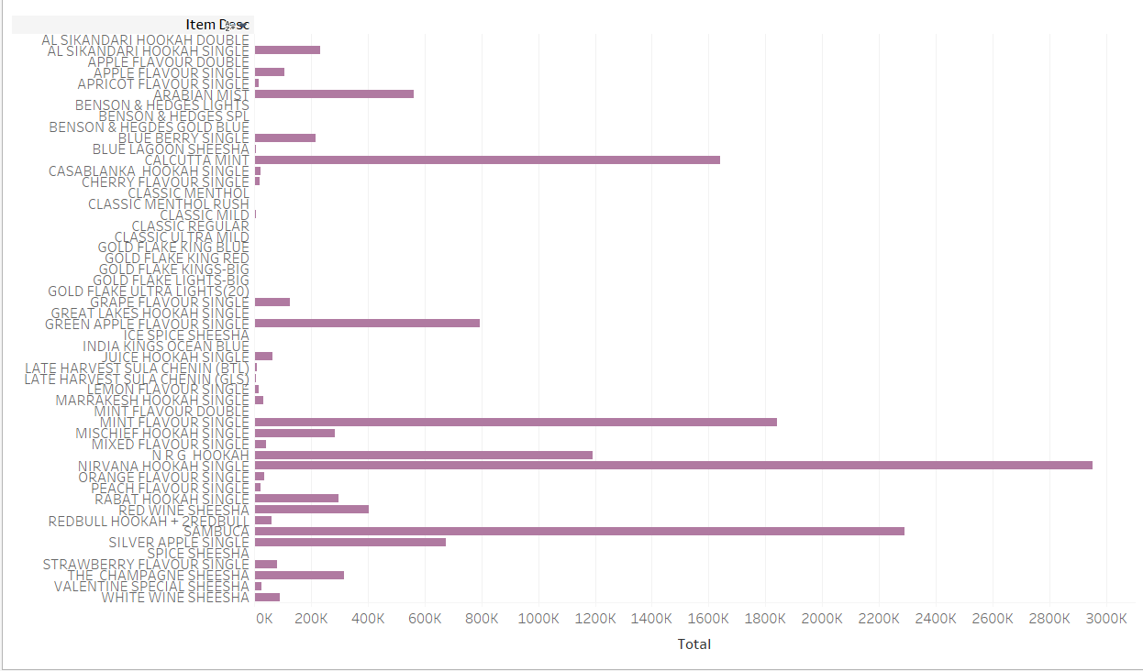

Tobacco that are sold less

Slide 44
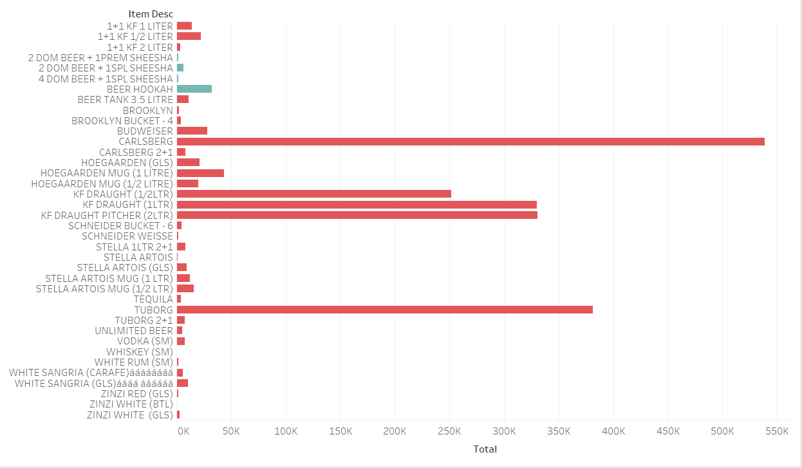

Liquor, Liquor & Tobacco that are sold less

Slide 45
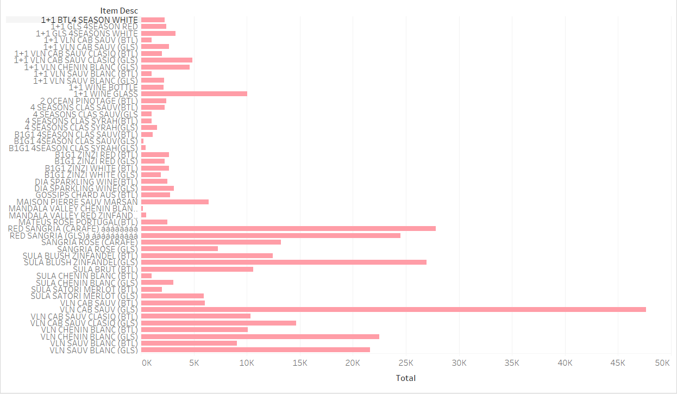

Wines that were sold less than 5 times

Slide 46
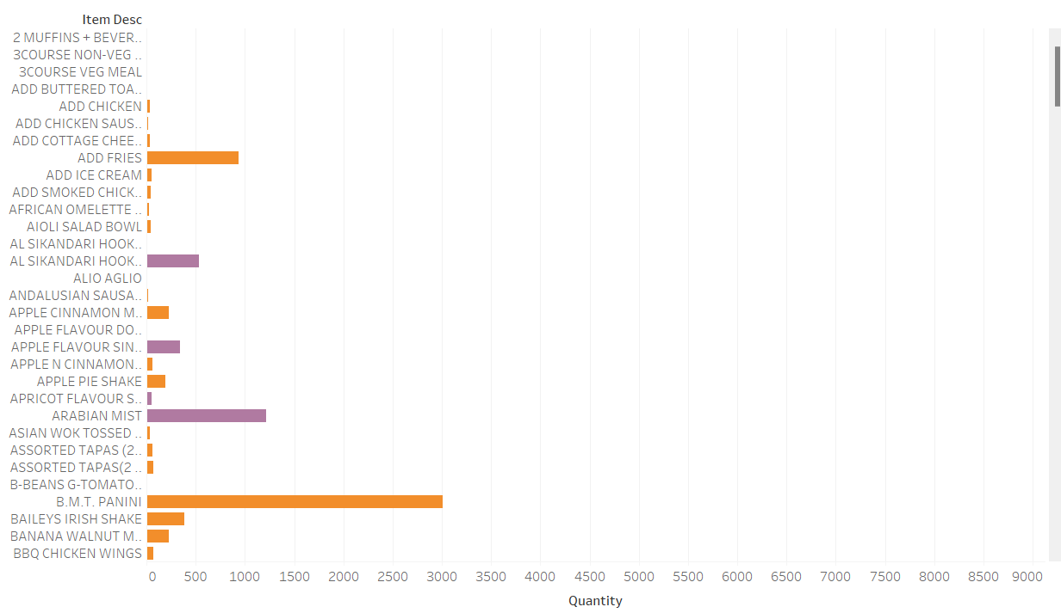

Food + Tobacco
Notes:
Here we have just posted a snapshot of the data. More information is already attached in the table which can be checked easily.

Slide 47
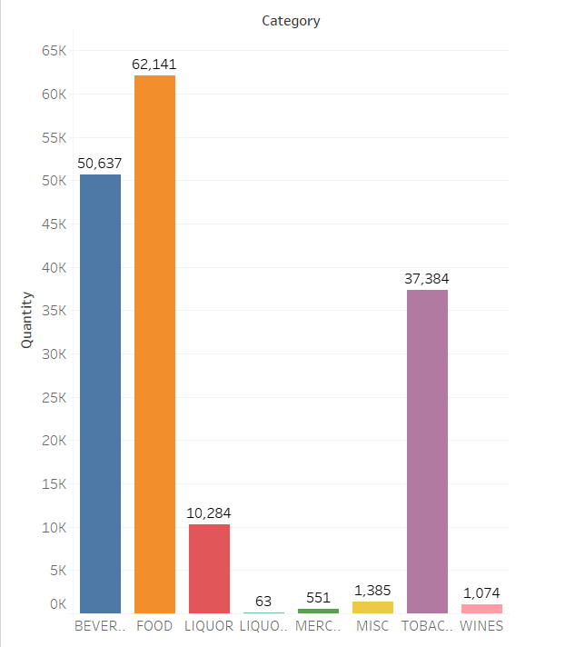
Food + Tobacco

Slide 48
Recommendation (Food + Tobacco)
Number of Tobacco orders are 37,384
Number of food orders are 62,141
Number of Tobacco only orders are 21,984
Number of orders with food and tobacco are 11,726
Most bought food items are Poutine with fries (3741 times) and Great Lakes snake (5914 times). Cost of poutine with fries is 125 and the snake is 110.
Either of them can be combined with a tobacco alongside a beverage and 20 to 25% of discount can be applied for the combo to see a bigger turnout.

Slide 49
Recommendation (Food + Beverage)
Number of beverage orders are 30,717
Number of food orders are 32,422
Number of food only orders are 16,648
Number of orders with food and beverages are 15,774
Most bought food items are poutine with fries (3741 times) and great lakes snake (5941 times). Cost of poutine with fries is 125 and the snake is 110.JR.CHL.Avlanche also seems to be popular (3446 times)
Either of them can be combined with a cappuccino and 15% of discount can be applied for the combo to see a bigger turnout.

Slide 50
Summary and Conclusion
33,710 (close to 40%) of the bills belong to Tobacco which is alarming and would suggest restricting tobacco sales to only nights to act socially responsible.
Combo introductions can drive people towards choosing food thereby bringing down tobacco orders.
These are hours across the day where sales contribute to less than 0.2% of the total and hence café can consider revisiting then open hours (close it during off peak hours) and it can save big on resourcing.
There are several items which are sold less than 50 times across a year and all of them can be removed as they are not moving as expected. Here I have selected items that were sold less than 20 times for delisting but this can be expanded to at least 50 as they are not contributing much to the revenue.
Maintain customer database to communicate the change in orders and also offer special discounts for loyal customers to promote the café.

Slide 51
Thank You !!!!

